Slide 1
HYDROGEN COUNCIL
Hydrogen Scaling Up
28 November 2018

Slide 2
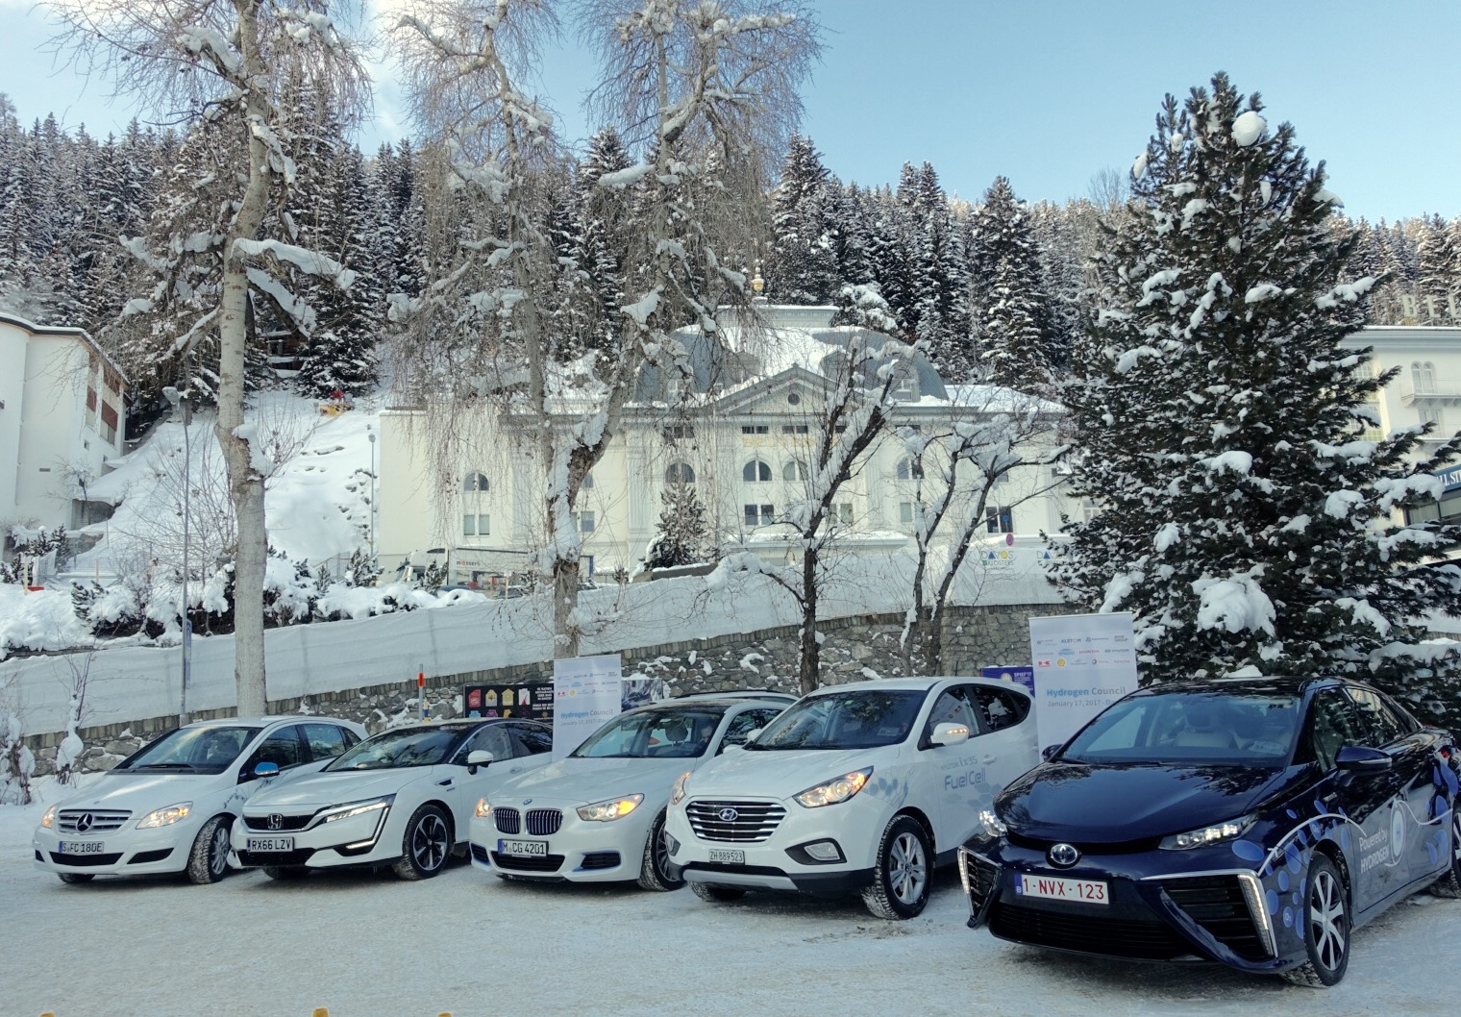
The Hydrogen Council - Introduction
At the World Economic Forum in Davos
Bringing together leading
energy, transport & industry
multinationals around the world
To provide high level vision
Launched in January 2017
Worlwide exchange platform for key industry stakeholders
Top level international advisory entity for high level decision makers
Global CEO-led initiative to foster the role of hydrogen in global energy transition
2
Notes:
Comes from discussion with partners, especially Toyota : we shared the same understandingg with the vision that hydrogen is a tremendous energy vector that will be needed in the future and that there is market opportunities. For this we need:
We need to work together to bring technologies to market readiness level, this all along the value chain
We need to work with public and the financial sector to share market risks and ensure proper financing of the deployments
We need is to scale up to bring costs down to competitiveness level, no experimentation projects anymore
We need this all around the world, cos again we need volume
We are organised around 2 main objectives:
Gather the actors along the value chain for us to ensure proper industrial developments of key components and comprehensive deployments
Target key decision markers, advocate to public decision makers, investors and media role hydrogen can play in the energy transition therefore the benefits we would have economically and environmentally to deploy this solution.
To achieve these objectives we have developed several means or developing toolboxes:
Events : Our annual CEO event or topics event bring together top leaders of key industrial players
Hydrogen Package : simple term for a complex advocacy actions : Purpose is to have a consistent and comprehensive deployment plan + supportive legislations in parallel in many countries to ensure volume to decrease costs and proper sector coverage and attract private financial sector
Quantified vision of the hydrogen role in the energy system with deployment roadmap:
At global level : Hydrogen scaling up study > First step : quantified vision of the hydrogen role in the energy system with deployment roadmaps at global level : gives a methodology that can be replicated at national level and based on which countries can develop hydrogen deployment plan as in Japan
Second step: Impulse roadmap development coherent with global study at national level with H2C members leverage
Third step and beyond: provide tools for key decision makers
Multilateral dialogs with key international organisations to specific objectives : R&D with Mission Innovation, Energy scenarii with IEA, Financial tools with Wolrd Bank etc
Studies to feed Toolboxes development : Policy benchmarks, financing schemes, costs competitiveness

Slide 3
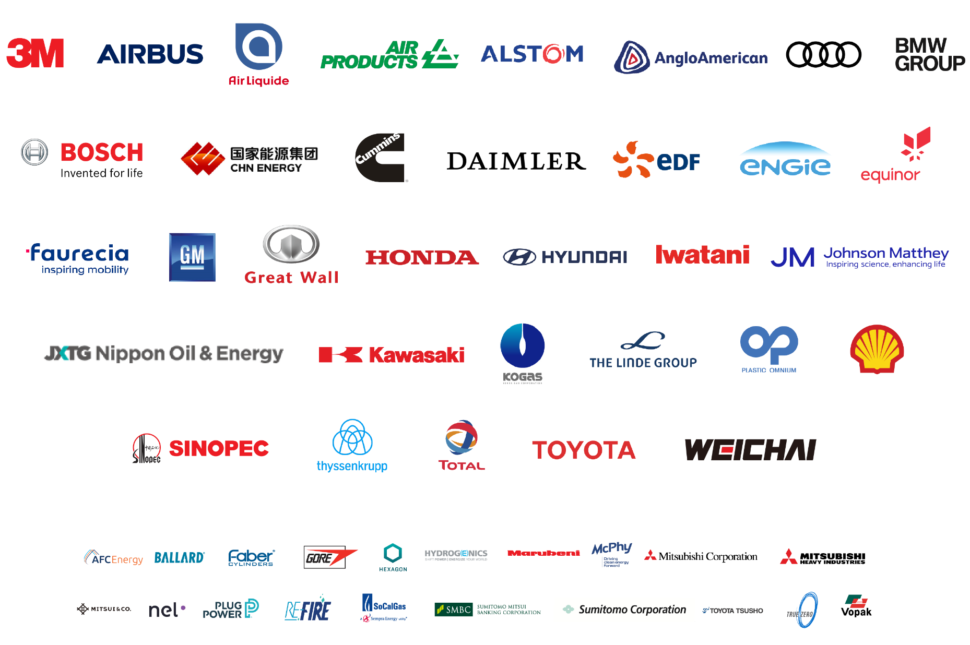
A STRONG & DYNAMIC GROUP

Slide 4
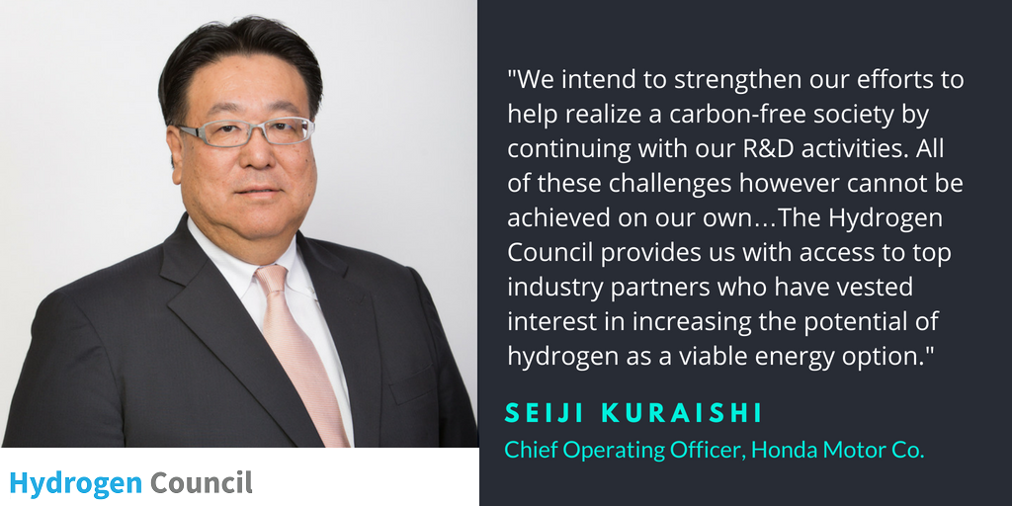
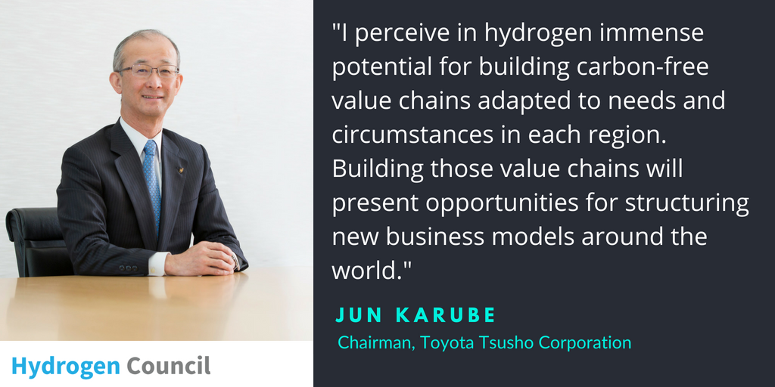
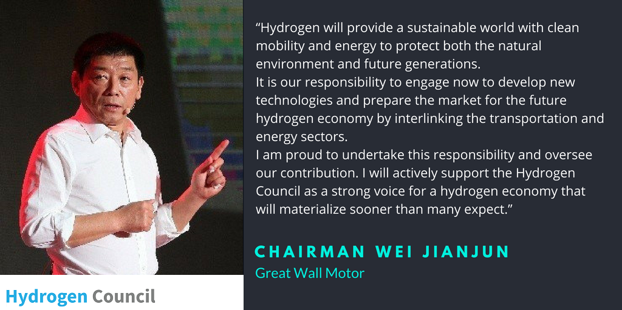
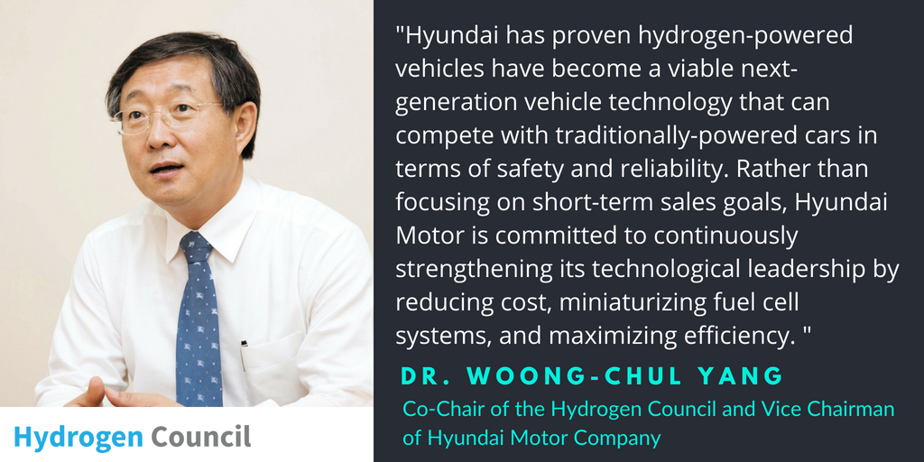
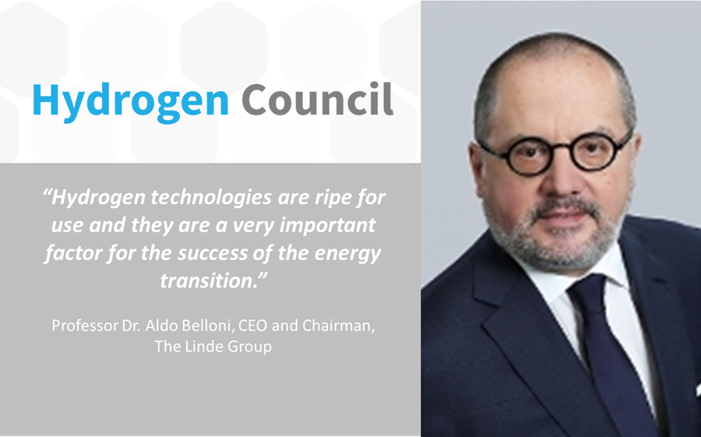
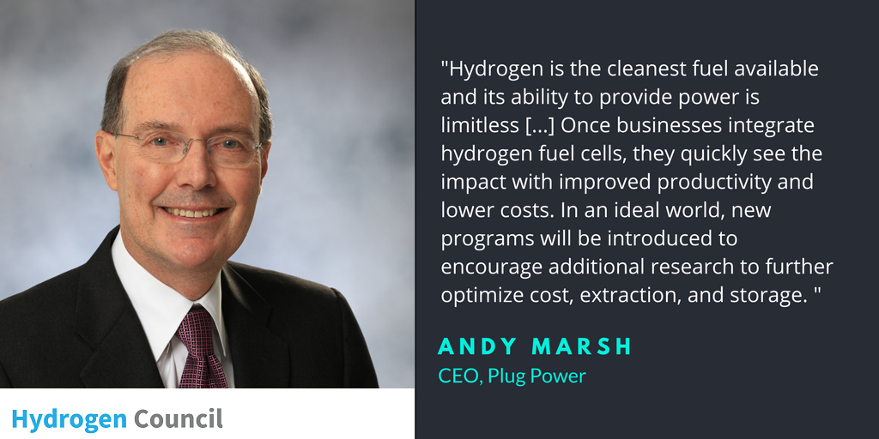
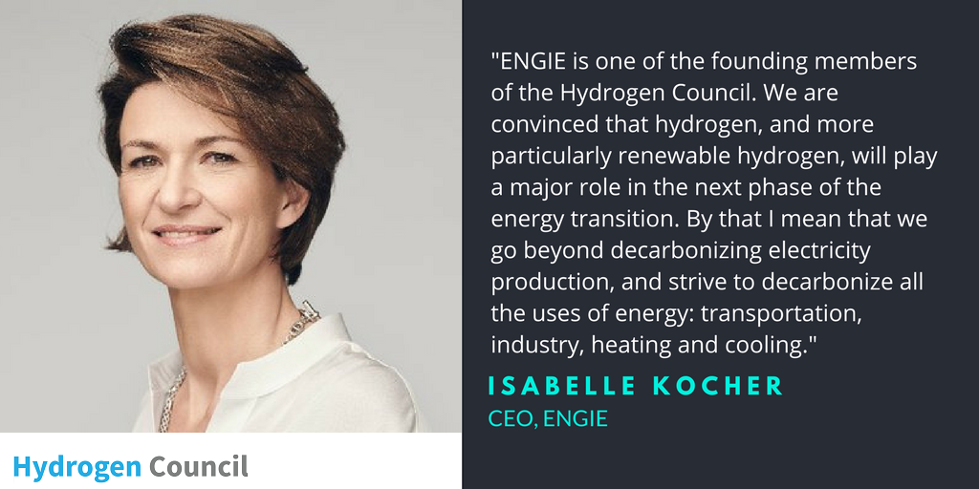
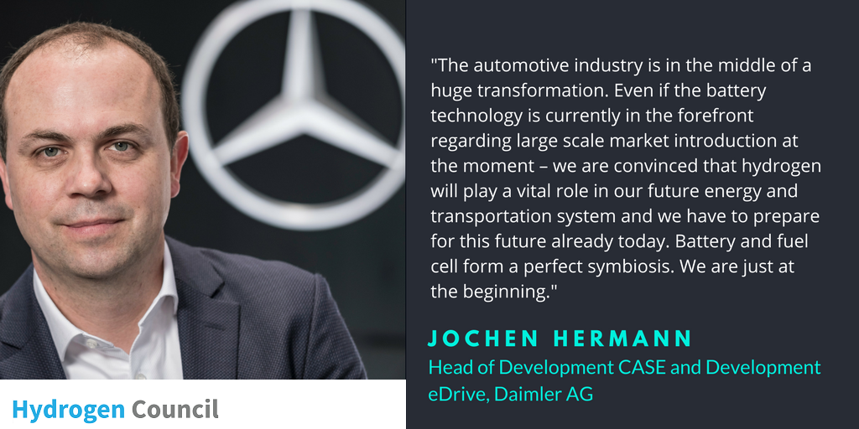
MOBILISED TOP LEADERS

Slide 5
SHAPING A JOINT VISION To foster h2 in political agenda
Common Studies
Catalysed “local scale up” studies
Collaborations & partnerships
Notes:
Delivered new studies to show the role of hydrogen technologies in the global energy transition and the benefits of hydrogen’s scale deployment
in a 2°C scenario.

Slide 6
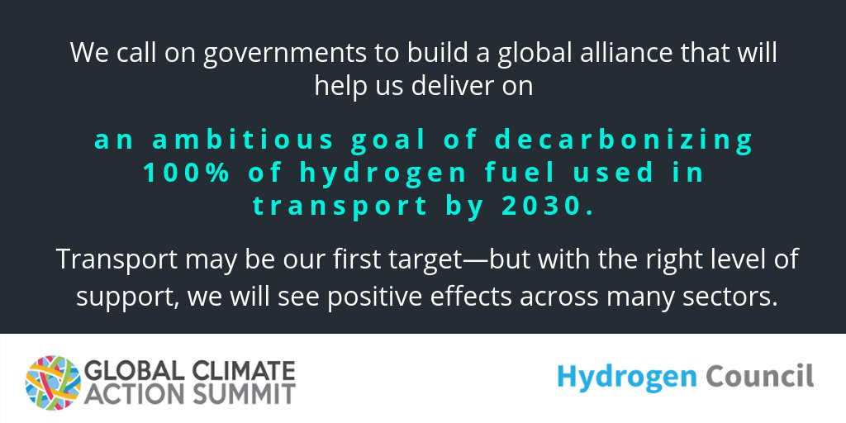
COMMITMENTS CEO meeting - San Francisco, USA – September 2018

Slide 7
VISION & AMBITION
2020+
New financing tools → Massive deployments phase
2019
“Hydrogen Package” in top markets → Further deployment announced
2018
Hydrogen part of key discussions and fora → New markets tested
A roadmap to competitiveness based on scale & cost
Policy tools (best practice)
Financing tools (best practice & innovative ideas)
Flagship projects ready for scaling collaboration

Slide 8
Hydrogen
scaling up
A sustainable pathway for the global energy transition
Hydrogen Council | COP 23 | 13 NOVEMBER 2017
Notes:
First comprehensive quantified vision and roadmap for deployment
Ambitious yet realistic
Integrated study of Hydrogen Council and McKinsey

Slide 9
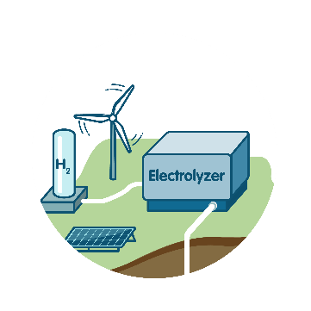
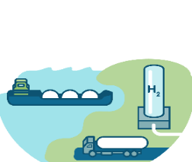
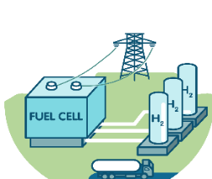
The energy transition creates multiple challenges
Enable the renewable energy system
Decarbonize end uses
Intermittent renewable power generation
Electrification in end use sectors
Increasing renewables share leads to imbalances of power supply & demand
Infrastructure needs to go through a major transformation
Some energy uses are hard to electrify via the grid or with batteries:
Transport
Industry
Residential heating
x10
by 2050 to >50 TWh per day
+75%
from ~70 EJ today to ~130 EJ by 2050
Renewable energy storage
Using or storing carbon
+18 EJ
From fossil-fuel based energy storage today to renewable by 2050
+5.5 Gt from very little today to 5.5 Gt by 2050
Global buffering capacity is currently based on mostly fossil sources
SOURCES: Hydrogen Council, IEA

Slide 10
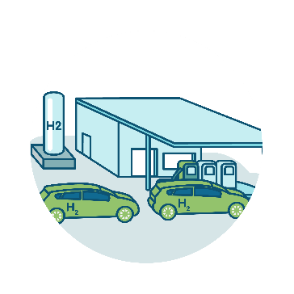
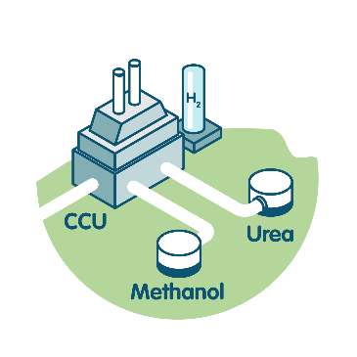
Hydrogen can help mitigate all these challenges
Enable the renewable energy system
Decarbonize end uses
4
Decarbonize transportation
Enable large-scale
renewables integration and power generation
Distribute energy across sectors and regions
5
Decarbonize industrial energy use
1
2
6
Help decarbonize building heat and power
3
Act as a buffer to increase system resilience
7
Serve as renewable feedstock
SOURCE: Hydrogen Council

Slide 11
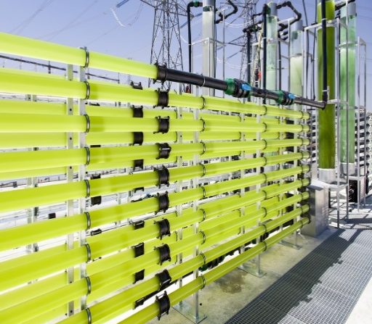
Hydrogen can benefit the energy system, environment and economy
Estimated impact in 2050
18%
$2500 bn
of final energy demand
annual sales
(hydrogen and equipment¹)
6 Gt
30
annual CO₂
abatement
million jobs
created
1 Value add of fuel cells
SOURCES: Hydrogen Council, IEA ETP Hydrogen and Fuel Cells CBS, National Energy Outlook 2016
Notes:
Global demand and supply could reach X EJ by 2030, X EJ by 2050

Slide 12
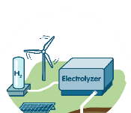
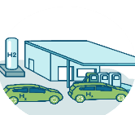
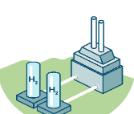
Hydrogen could provide ~18% of energy demand in a 2-degree world
Potential global energy demand supplied with hydrogen, Exajoule (EJ)
78
1
Power generation,
buffering
4
Transportation
5
18%
Industrial energy
of final energy demand
28
6
Building heat and power
14
10
7
8
New feedstock (CCU, DRI)
10
Existing feedstock uses
2015
20
30
40
2050
SOURCE: Hydrogen Council

Slide 13
The technologies exist and are ready to be deployed
Start of commercialization
Mass market acceptability¹
1
Power generation
In renewables-constrained countries
In other countries
4
Trans- portation
Forklifts
Medium and large cars
City buses
Vans
Coaches
Trucks
Trams and railways
Small cars
Synfuel for freight ships and airplanes
Minibuses
Passenger ships
5
Industrial energy
Medium-/low industry heat
High-grade industry heat
6
Building heat and power
Blended hydrogen heating
Pure hydrogen heating
7
Industry feedstock
Refining
Production of methanol, olefins and BTX using H₂ and captured carbon²
Ammonia, methanol
Steel³
Decarbonization of feedstock⁴
Today
2020
25
30
35
40
2045
1 Mass market acceptability defined as sales >1% within segment in priority markets 2 Market share refers to the amount of production that uses hydrogen and captured carbon to replace feedstock
3 DRI with green H₂, iron reduction in blast furnaces and other low-carbon steel making processes using H2 4 Market share refers to the amount of feedstock that is produced from low-carbon sources
SOURCE: Hydrogen Council

Slide 14
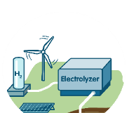
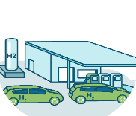
Hydrogen has significant potential across all applications
Bubble size indicates hydrogen potential in 2050 in EJ (1 EJ)
1
Power generation
Power ge-
neration
Buffer¹
Passenger ships
4
Small cars
Trucks
Vans & minibuses
Trans- portation
Mid-sized/ large cars
Forklifts
Trains & tramways
Synfuel²
Coaches & buses
5
Industrial energy
High-grade industry heat
Medium-/low industry heat
6
Building heat and power
Heating/co-generation
in countries without gas networks
Heating/co-generation in countries with gas networks
7
Industry feedstock
CCU for methanol, olefins, BTX3
Ammonia,
methanol
Steel (DRI)
Refining
0%
10%
20%
30%
40%
60%
80%
100%
Relative importance by 2050 Market share potential in segment
1 Percent of total annual growth in hydrogen and variable renewable power demand 2 For aviation and freight ships 3 Percent of total methanol, olefin, BTX production using olefins and captured carbon
SOURCE: Hydrogen Council

Slide 15
In transport, industry and buildings hydrogen could contribute 40-60% of required CO₂ abatement
Required CO₂ abatement for 2DS²
Gt
Potential contribution from hydrogen
Share of required CO2 abatement
1
Power generation, buffering
12.9
~ 3
4
5.8
~ 40
Transportation
5
7
Industry energy
4.6
~ 40
Industry feedstock
6
Building heating
and power
1.1
~ 60
Other
2.3
Total
26.6
~ 20
1 Aviation, shipping, rail, material handling
2 Difference between IEA Reference Technology and 2 degree scenario
SOURCES: IEA, Hydrogen Council

Slide 16
Milestones for 2030 on the path to the 2050 vision
4
1 in 12 passenger cars sold powered by fuel cells in early-adoption markets: Germany, California, Japan and South Korea
5
3.5 Mt hydrogen used for high-grade heat in first large-scale projects
6
50 million households connected to a network safely blending hydrogen and natural gas
7
20 Mt CO₂ converted to chemicals and intermediates such as methanol using hydrogen
SOURCE: Hydrogen Council

Slide 17
Investing $280 billion until 2030 would create a market worth more than $140 billion annually
$ billion¹
Enable the renewable energy system
Decarbonize end uses
Total
Hydrogen production
Storage, transport, and distribution
End-uses in transportation, industry energy, buildings and feedstock
4
Investment
potential
2018-30
5
90+
280+
1
2
Annual
revenues
2030¹
6
70+
140+
3
7
1 Excluding existing feedstock uses, Considering only hydrogen value-added
SOURCE: Hydrogen Council

Slide 18
The case for acting now: Large-scale deployment initiatives underpinned by long-term policy frameworks to attract investors
Industry
Investors
Accelerate development and commercialization of products and build-out infrastructure to support large-scale deployment
Finance infrastructure and value chain development for large-scale deployment
Urgency to initiate scale-up to meet climate change targets
Hydrogen technology proven in a wide range of applications
Industry players ready to accelerate –
Hydrogen Council
Policymakers
Collaborate with industry to build national strategies and roadmaps and put in place long-term policy frameworks

Slide 19
THANK YOU!
@HydrogenCouncil #HydrogenNow

Slide 20
BACKUP

Slide 21
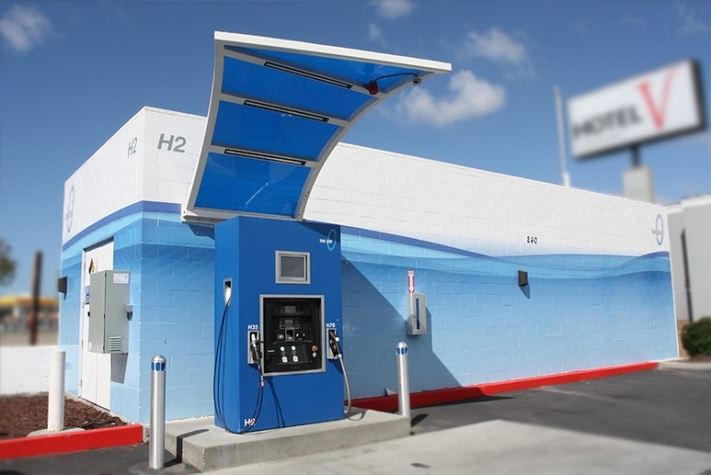
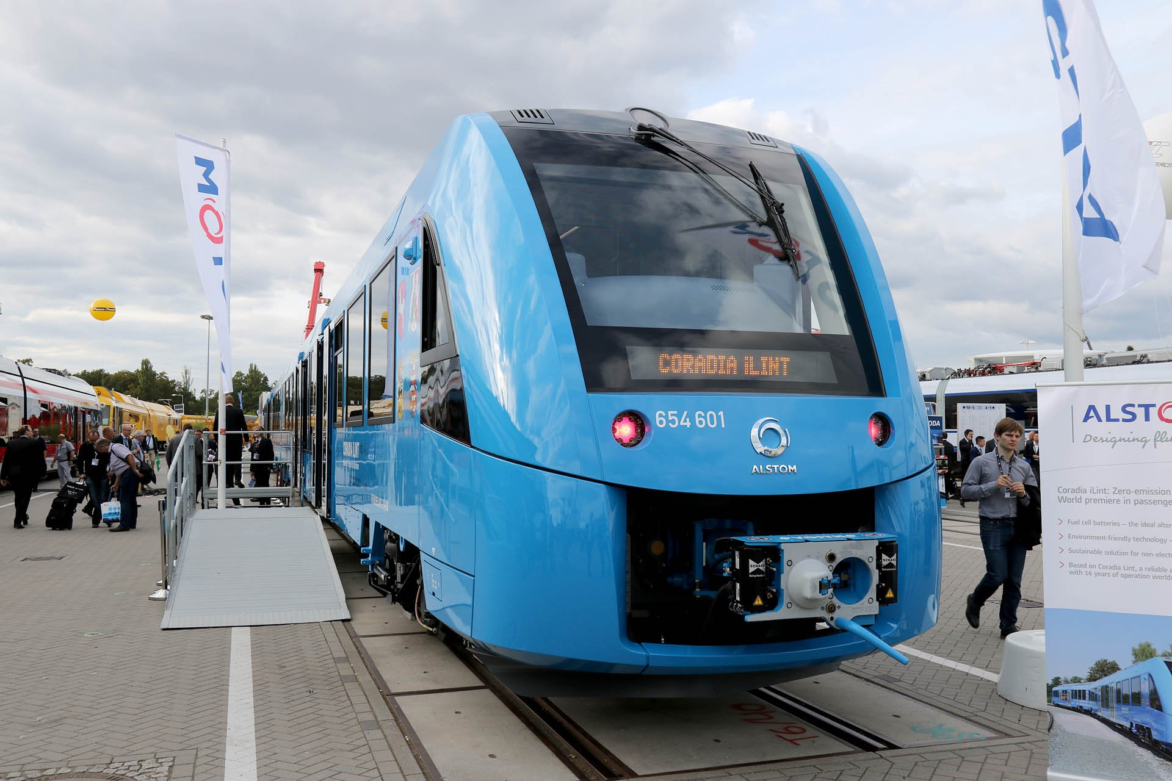
Transportation
4
Hydrogen and fuel cells are critical elements in the decarbonization of the transportation sector
FCEVs are a necessary complement to BEVs to achieve deep decarbonization of the transportation sector
They are convenient for consumers due to long ranges and fast refueling times and particularly competitive for heavily-used vehicles
Hydrogen-powered vehicles are commercially available now or within the next five years in medium-sized/ large cars, buses, trucks, vans, trains, and forklifts
Unit of measure
2030 milestones
2050 target picture
1 in 12 cars in Germany, Japan, South Korea, and California powered by hydrogen
Globally 10 to 15 million cars and 500,000 trucks powered by hydrogen
Deployment of hydrogen-powered trains and passenger ships
Up to 400 million passenger vehicles (~25%),
5 million trucks (~30%), and more than 15 million buses (~25%) running on hydrogen
20% of today’s diesel trains replaced with hydrogen- powered trains
20 million barrels of oil replaced per day, 3.2 Gt CO2 abated per year

Slide 22
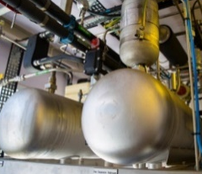
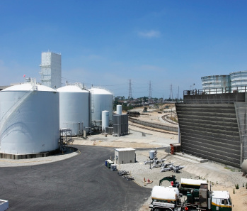
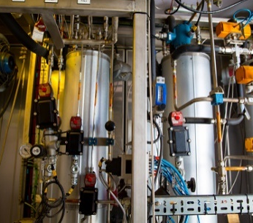
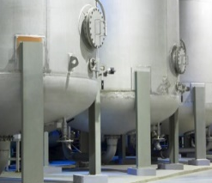
Industry energy
5
Hydrogen can provide decarbonized high heat for industrial processes
Clean or green hydrogen can be used as alternative to post-combustion carbon capture and storage
Hydrogen is the main option for decarbonization of industrial processes requiring high heat and/or combustion
Unit of measure
2030 milestones
2050 target picture
One in ten steel and chemical plants in Europe, North America, and Japan uses hydrogen for low-carbon production
4 million tons (0.6 EJ) additional hydrogen used
12% of global industry energy demand (16 EJ) met with hydrogen – 23% of high-grade, 8% of medium-grade, and 4% of low-grade heat and power
~1 Gt CO2 abated per year

Slide 23
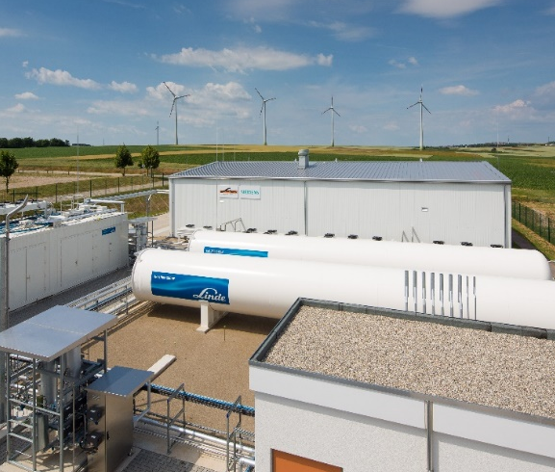
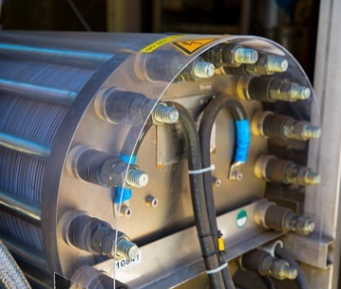
Building heat and power
6
Hydrogen can help decarbonize building heat and power
Hydrogen is a cost-effective option for decarbonization of building heat and power in regions with existing natural gas networks
It can be blended in concentrations of up to 20% with natural gas, converted to synthetic natural gas, or replace natural gas all together in 100% hydrogen networks
Unit of measure
2030 milestones
2050 target picture
The equivalent of 6.5 million households heated with blended or pure hydrogen using about 3.5 million tons (0.5 EJ) of hydrogen
10% of users connected to the hydrogen-natural gas grid using fuel cell combined heat and power units (micro-CHPs)
8% of global building energy use for heat and power (11 EJ) provided by hydrogen
About 700 Mt CO2 abated per year

Slide 24
Industry feedstock
6
Hydrogen as feedstock can be decarbonized and used to replace fossil feedstock
55 million tons of hydrogen are currently used as feedstock for refining, fertilizer, and chemical production – these can be decarbonized through clean production pathways
Other industries, such as methanol and iron production, can replace fossil feedstock with clean hydrogen and carbon
Unit of measure
2030 milestones
2050 target picture
Steel plants pioneering zero-carbon iron making using hydrogen reduction (using about 100,000 tons hydrogen)
10 to 15 million tons of methanol and derivatives, such as olefins and aromatics, produced from clean hydrogen and carbon (using about 2.5 million tons hydrogen)
Demonstration of clean hydrogen use in chemicals and refining industries
10% of crude steel production, about 200 million tons, based on hydrogen, saving 190 million tons of CO2 per year
30% of methanol and ethanol derivatives produced through hydrogen and carbon, recycling 360 million tons of CO2 per year
Existing feedstock uses for chemicals and refining industry decarbonized, saving 440 million tons of CO2 per year

Slide 25
Energy system
1-3
Hydrogen is a versatile energy carrier that can enable the renewable energy system
Hydrogen enables large-scale renewable integration through cost-effective long-term storage
It allows distribution of energy across sectors and regions
It acts as buffer to increase system resilience
It provides clean dispatchable power generation in peaker plants
Unit of measure
2030 milestones
2050 target picture
250 to 300 TWh of excess solar and wind electricity converted to hydrogen
More than 20 power plants generating
100 to 200 TWh of dispatchable power from clean hydrogen
More than 10 ships transporting a total of about 100,000 tons hydrogen per year
200 TWh hydrogen stored in underground salt caverns
500 TWh of excess solar and wind electricity converted to 1.5 EJ hydrogen
1,500 TWh of dispatchable power produced from 9 EJ clean hydrogen
55 million tons of hydrogen, or 8 EJ, transported/shipped overseas
3,000 TWh of hydrogen, or 18 EJ (worth 55 days of wind, solar, and hydrogen demand) stored in strategic reserves

